Slide 1
InfluxDB 2.0
Emanuele Della Valle
Prof. @ Politecnico di Milano & Partner @ Quantia Consulting
Marco Balduini
Founder & CEO @ Quantia Consulting

Slide 2
What is it? InfluxDB 2.0

Slide 3




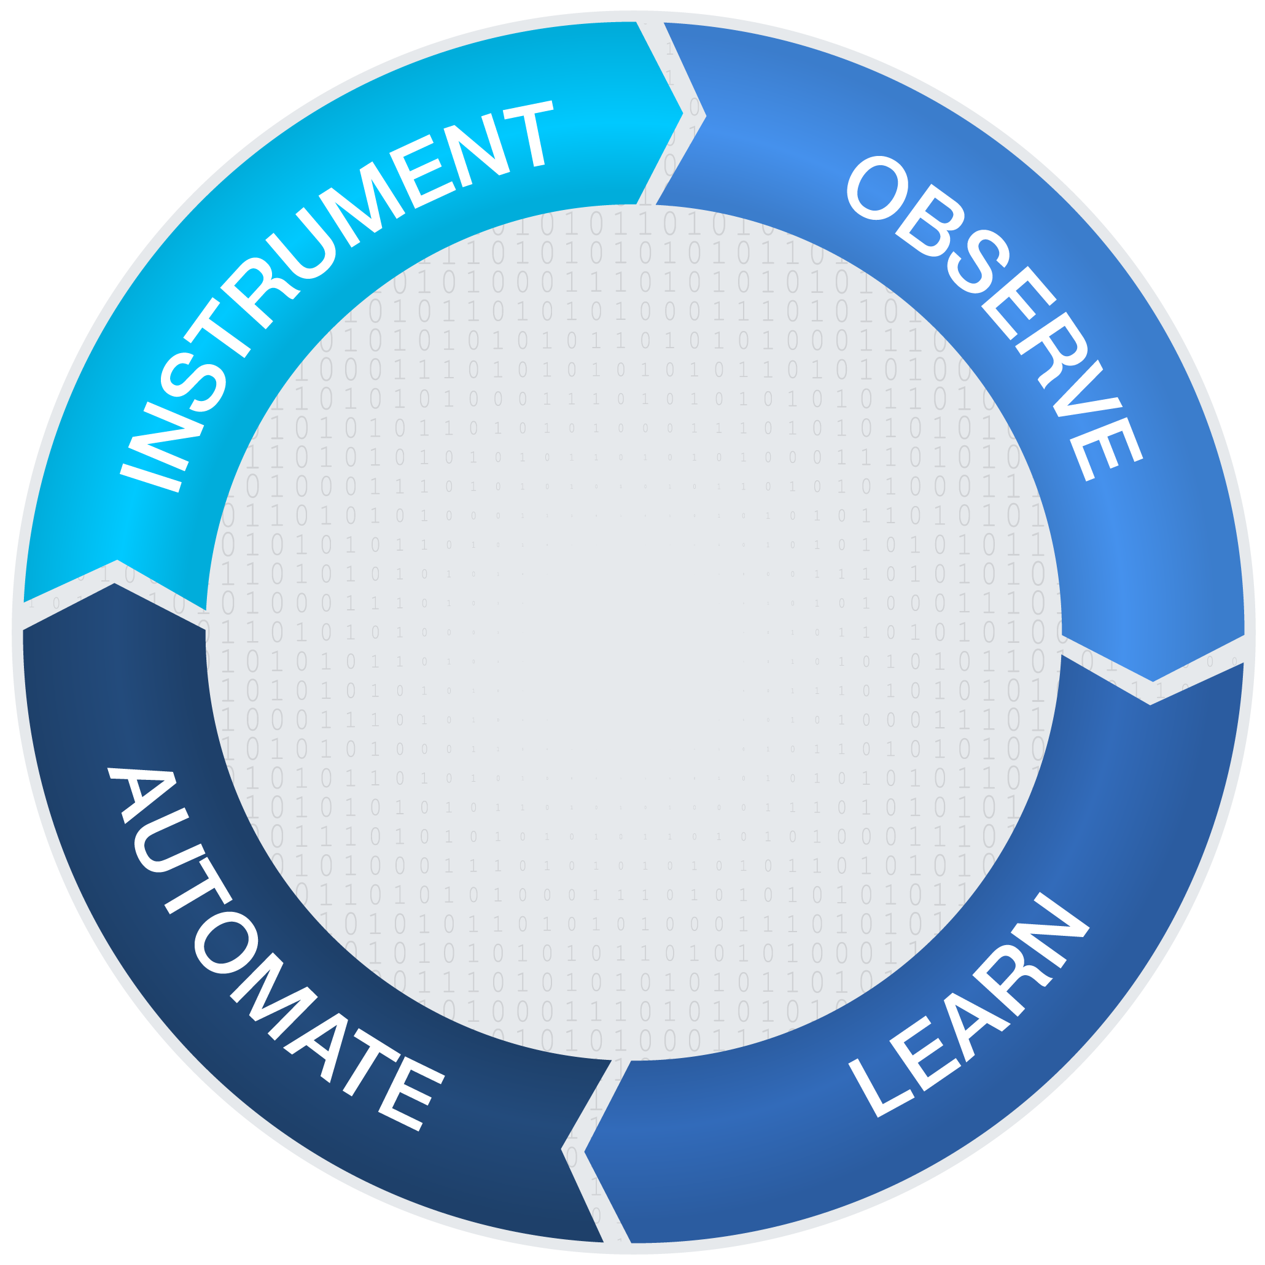


Platform Strategy:
Be The Platform of Choice for All Metrics and Event Workloads
IoT Sensor
Events
Business
Events
Common Metrics and Events Platform
Infrastructure
& Application Metrics
Application, Custom Logs & Traces

Slide 4
InfluxData Platform Features
INSTRUMENT
OBSERVE
Quickly ingest data from everywhere
Efficiently store (Compress) the data at scale
Support real-time query, analysis and visualization of large data sets
Provide time-based functions for “change over time”
AUTOMATE
Common Metrics and Events Platform
LEARN
Provide automation and control functions
Evict and down-sample data
Enable machine learning and anomaly detection
Provide streaming analytics for data in motion

Slide 5

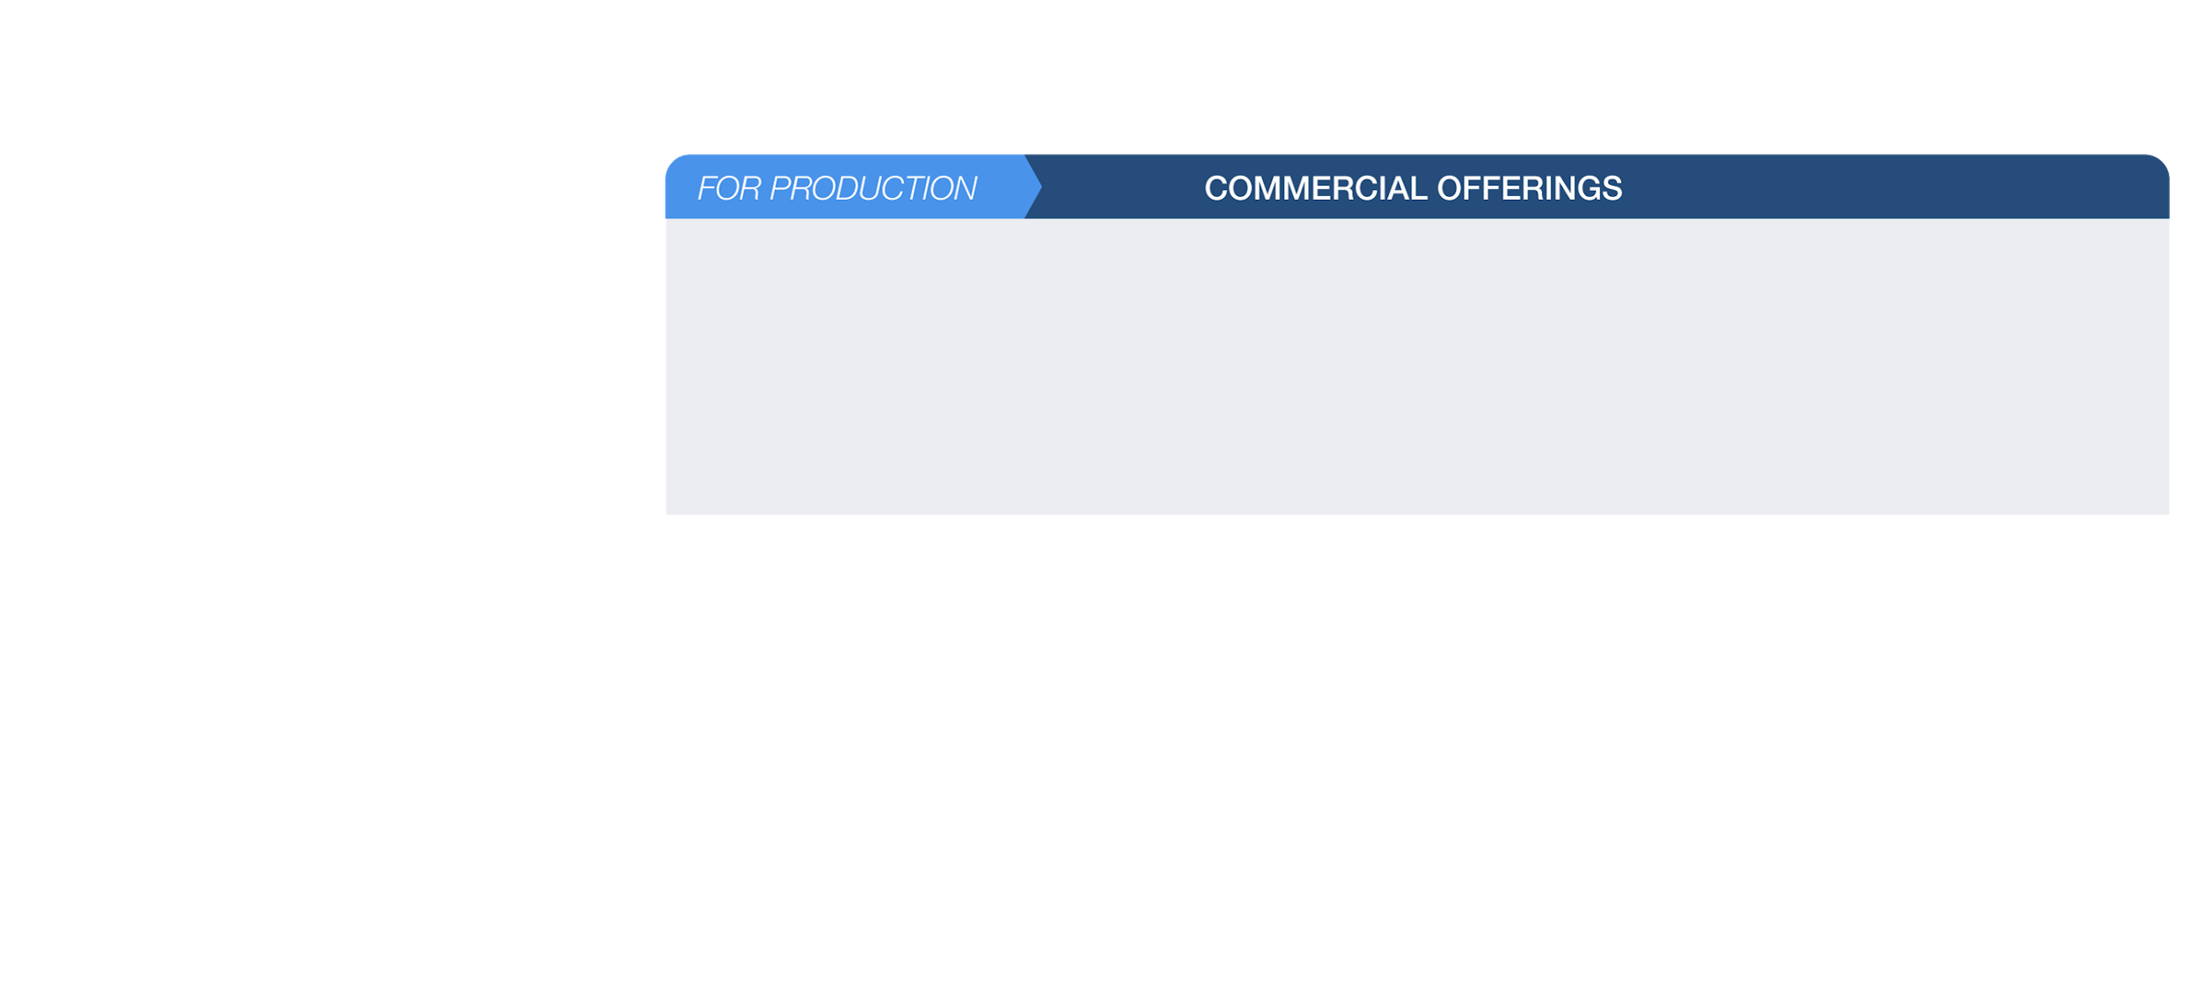
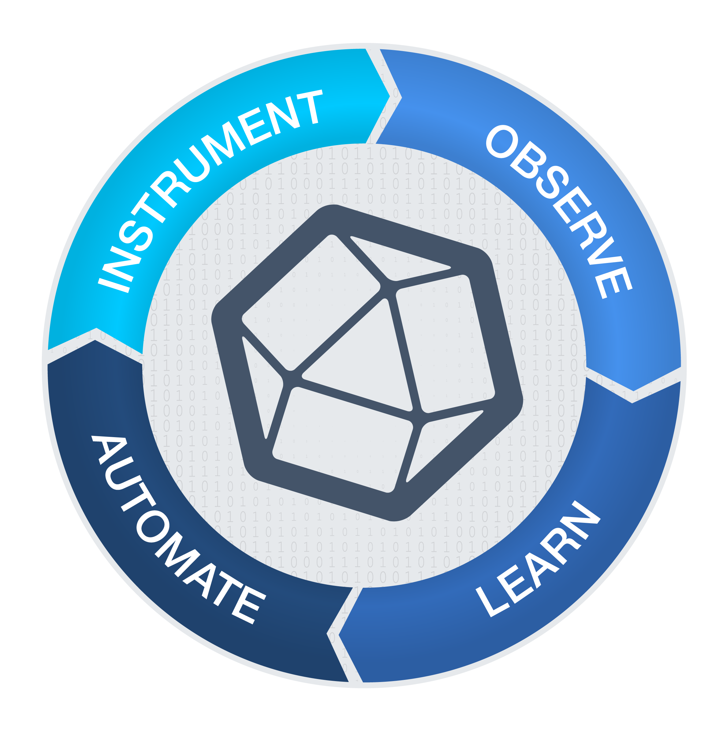
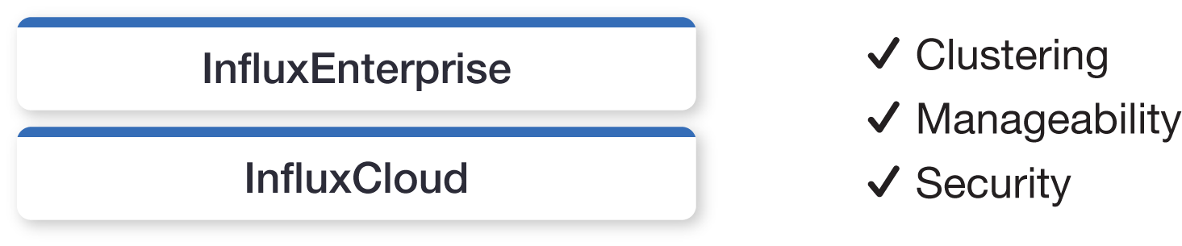
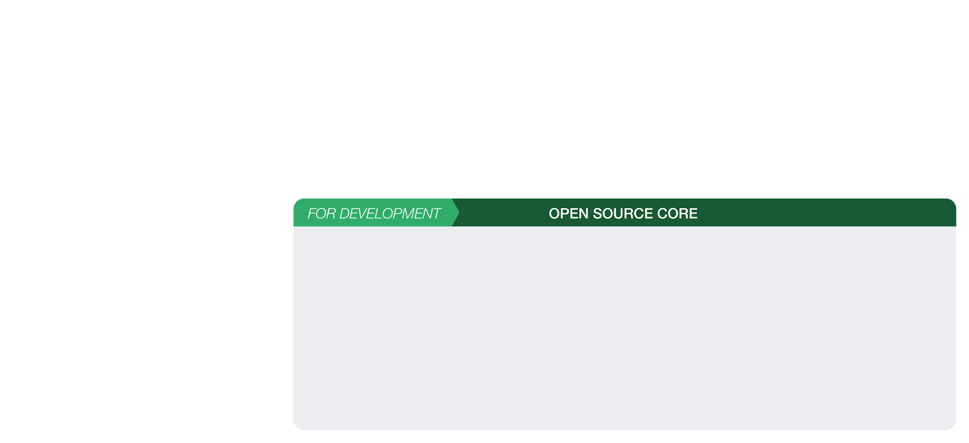
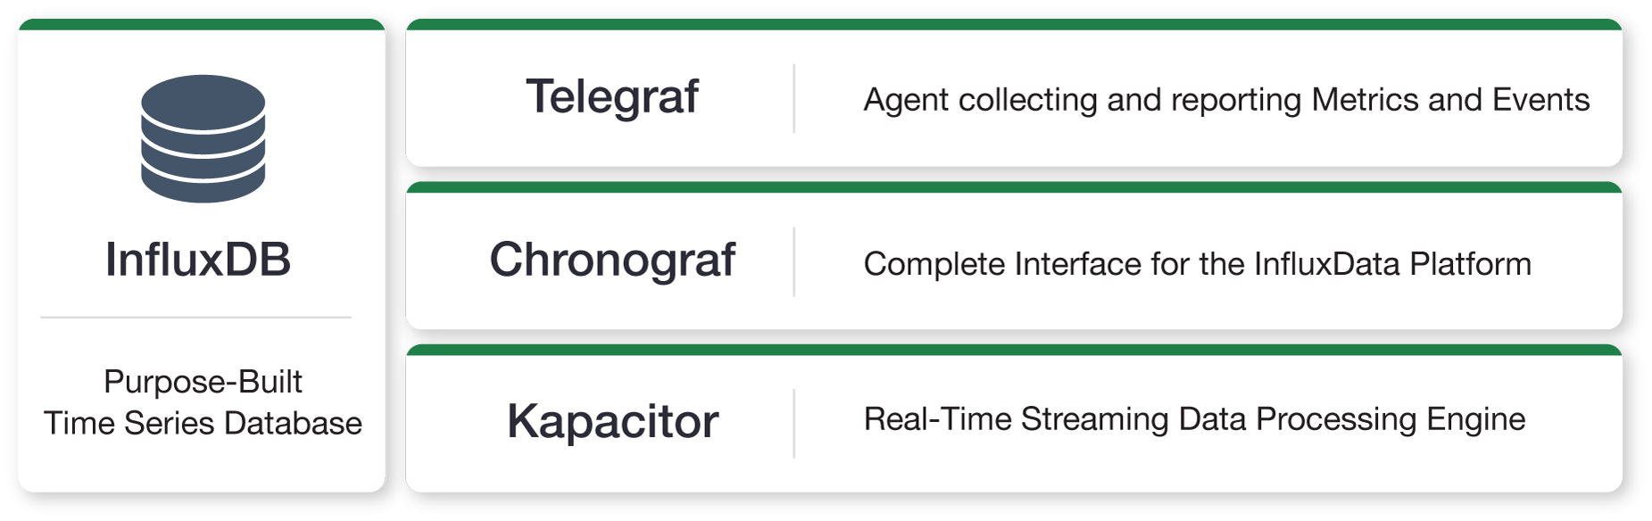
InfluxData Products and Offerings

Slide 6
What’s New in InfluxDB 2.0
The UI is very different
Key feature
From wizard to build out scripts in 1.x
To a visual query builder in 2.0.
Load data from the UI
Download Telegraph configuration
Dedicated API layer to serve UI for all deloyments (OSS, Cloud, and Enterprise)
Tasks are a brand new concept
Flux queries that can be scheduled
Tokens
secure third party systems to write or read data

Slide 7
DEMO InfluxDB 2.0

Slide 8
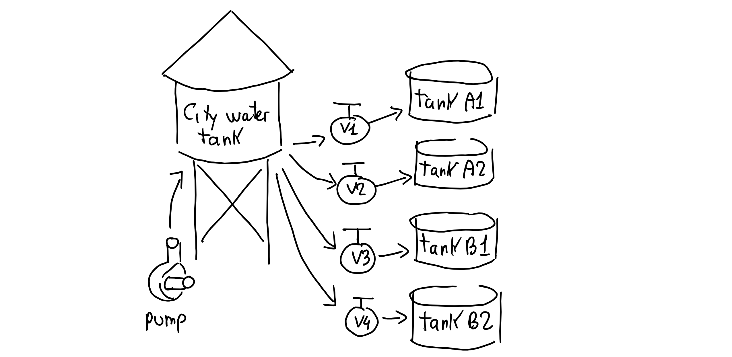
Scenario

Slide 9
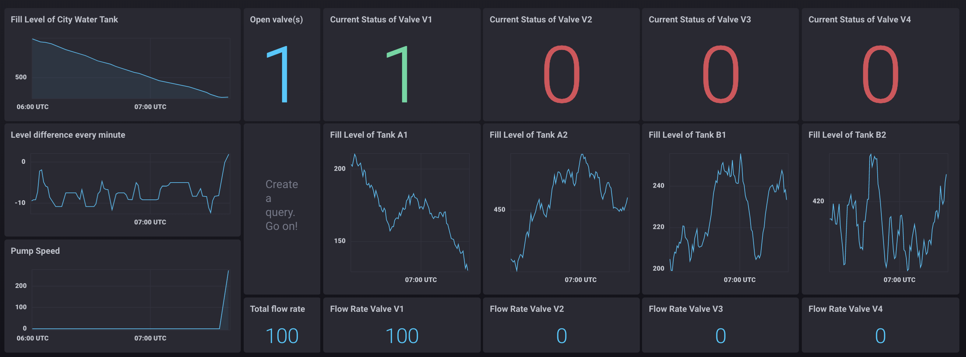
Dashboard
You will be able to do it yourself by the end of this training!
You will be able to do it yourself by the end of this training!

